Slide 1
Travel Agency Fusion
Ivan Petrov https://github.com/Nv4n/travel-agency-fusion

Slide 2
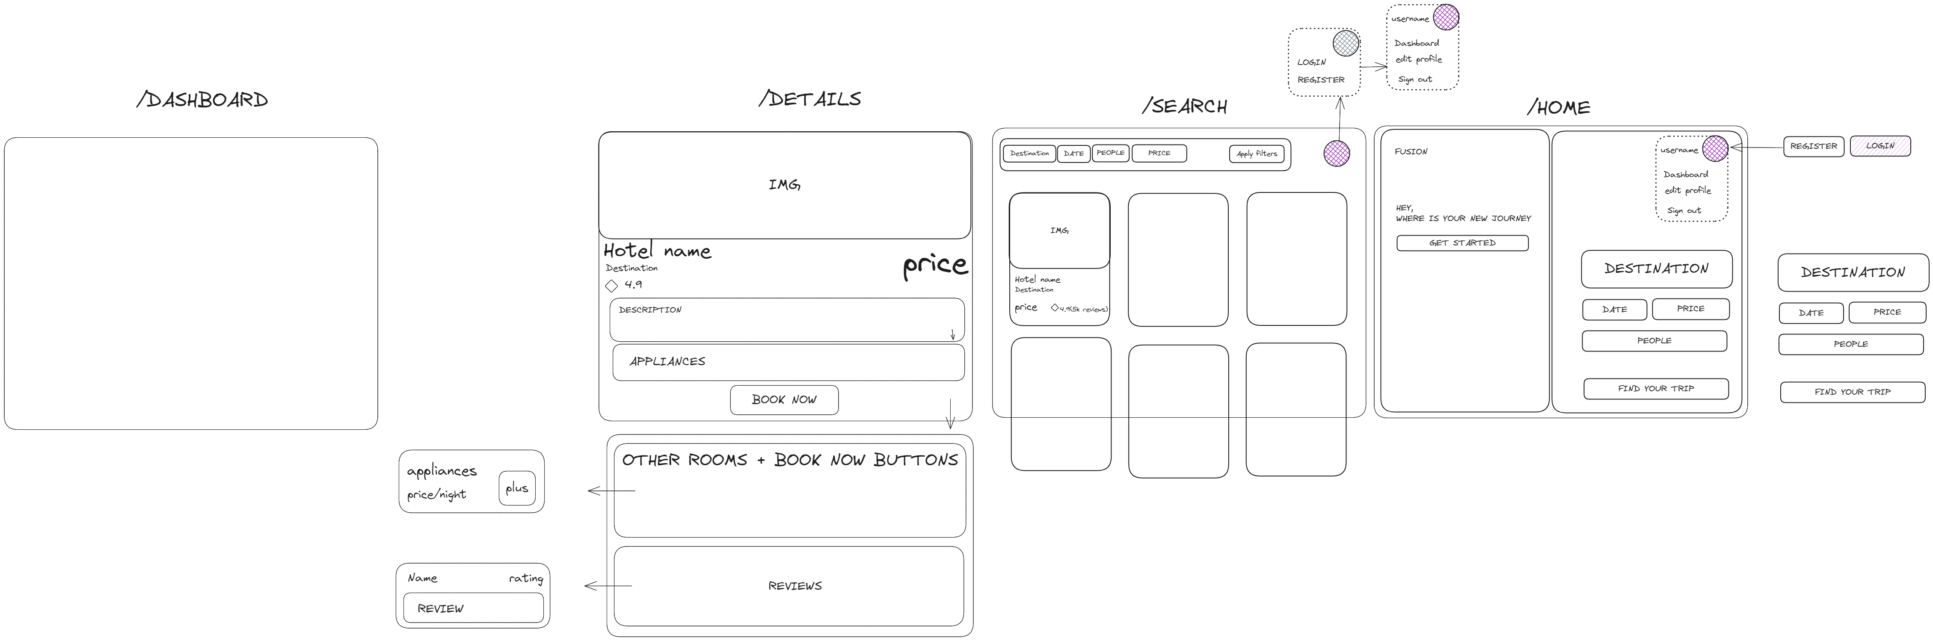
Mockup design

Slide 3
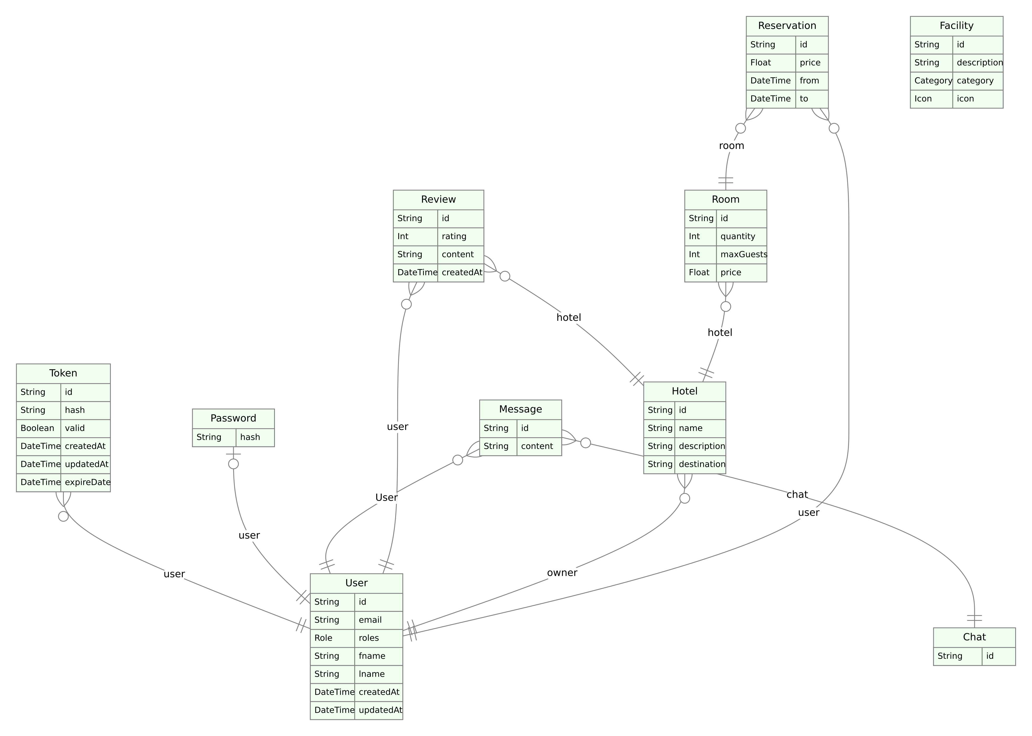
Database model

Slide 4
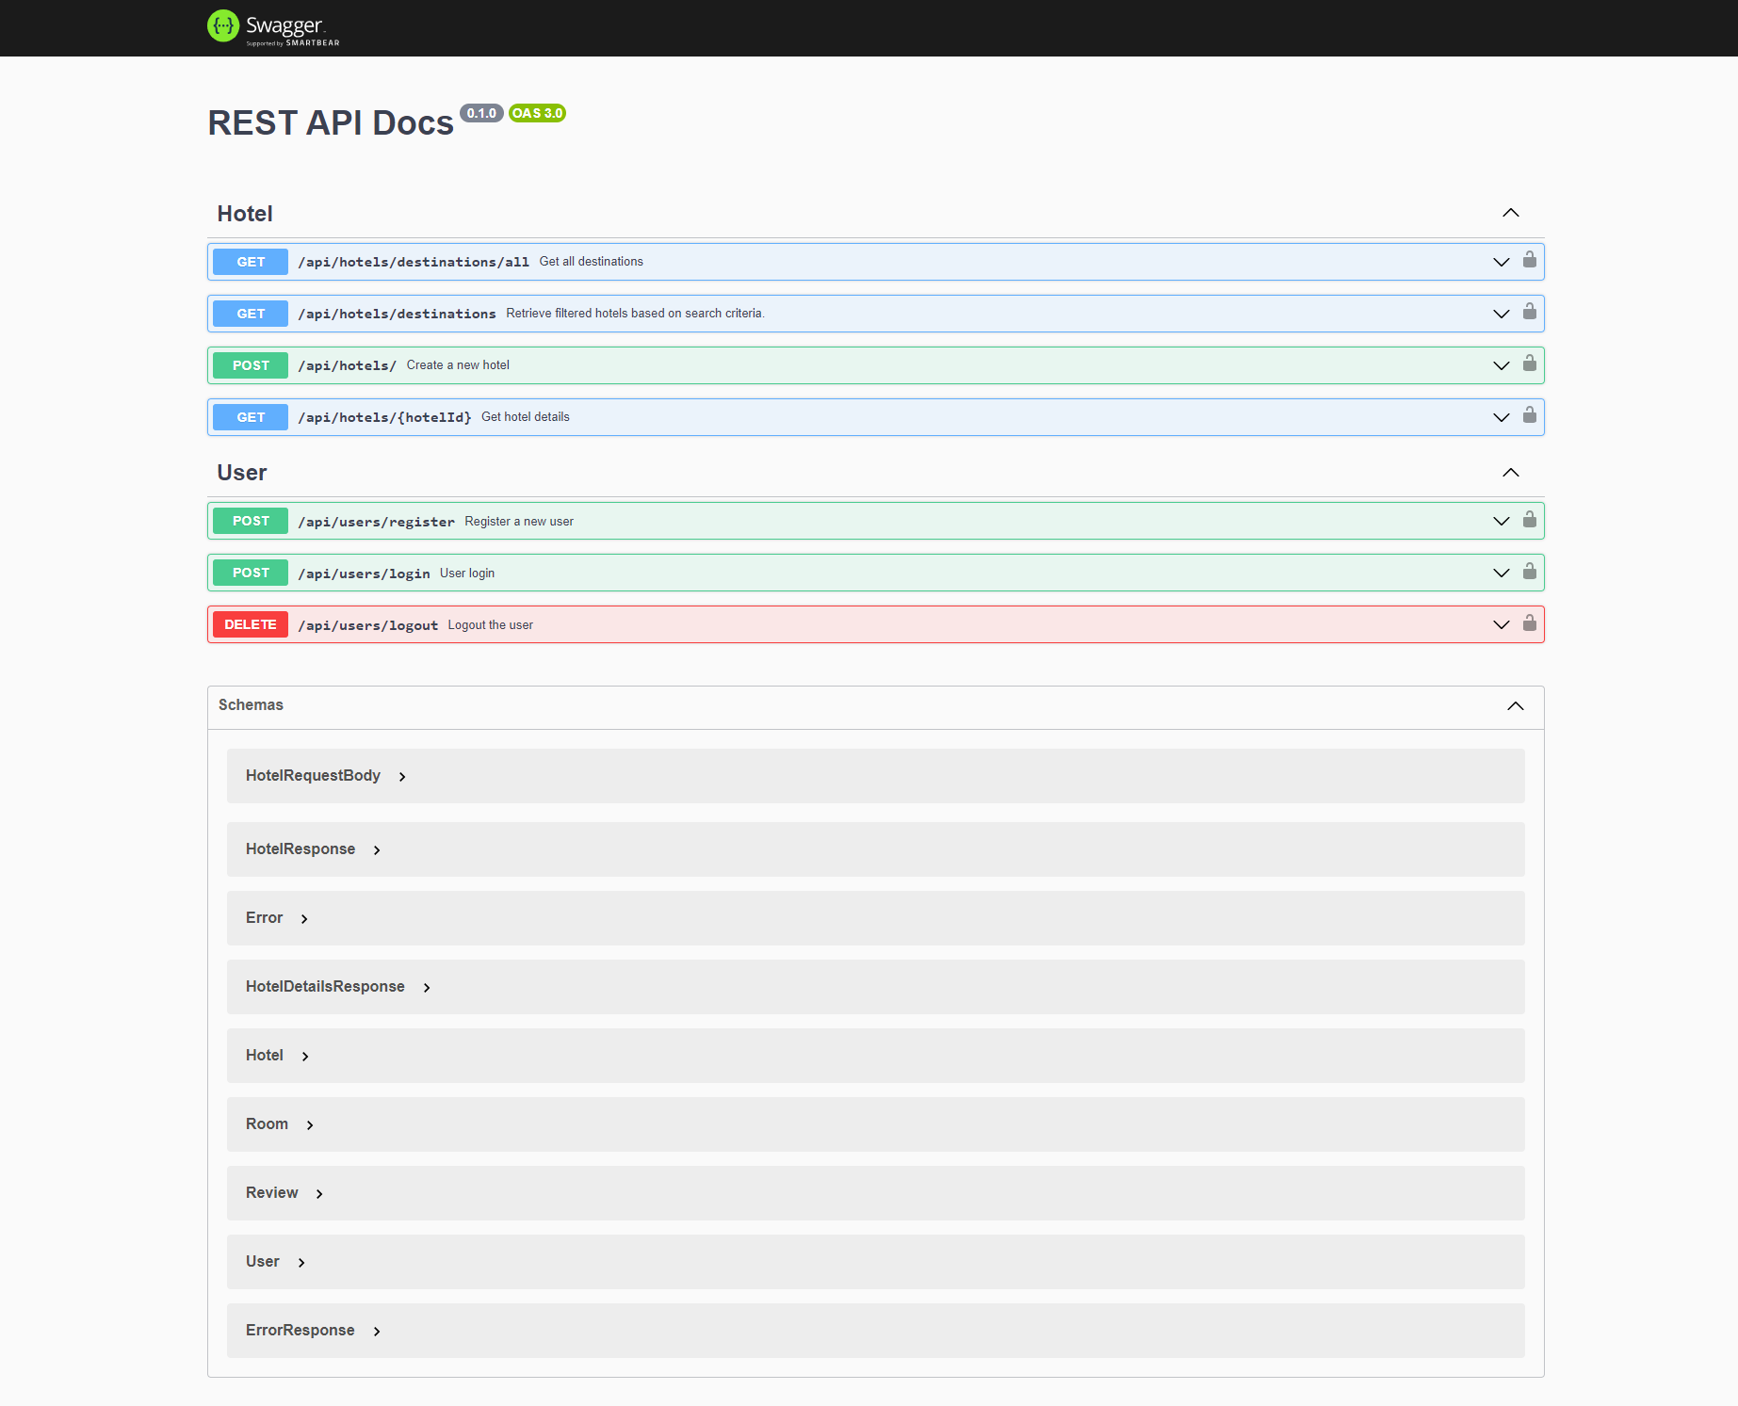
Api Overview

Slide 5
Authorization
JWT Access Token
JWT Refresh Token

Slide 6
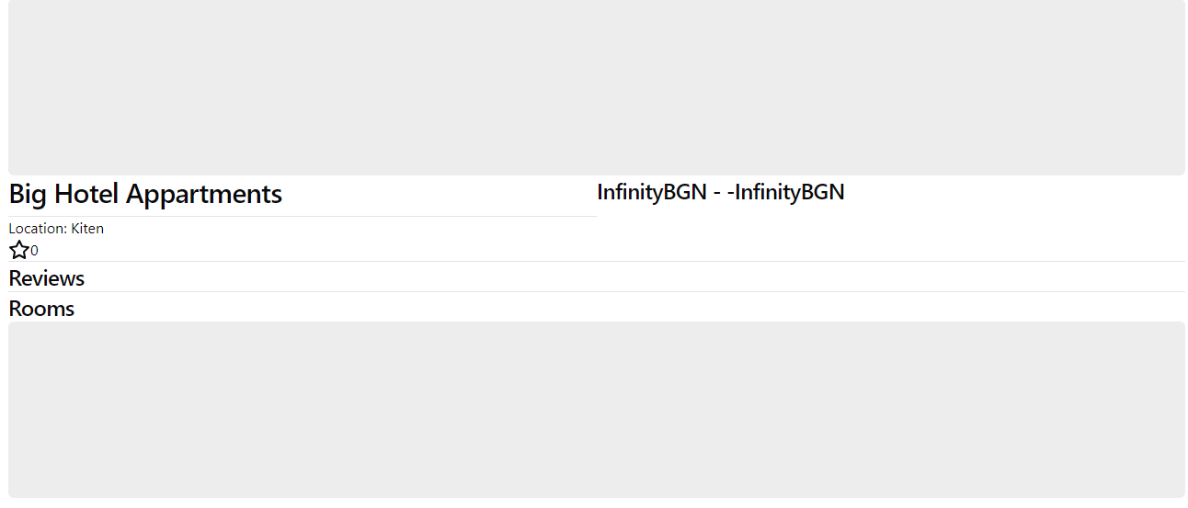

Realization: Hotel view

Slide 7
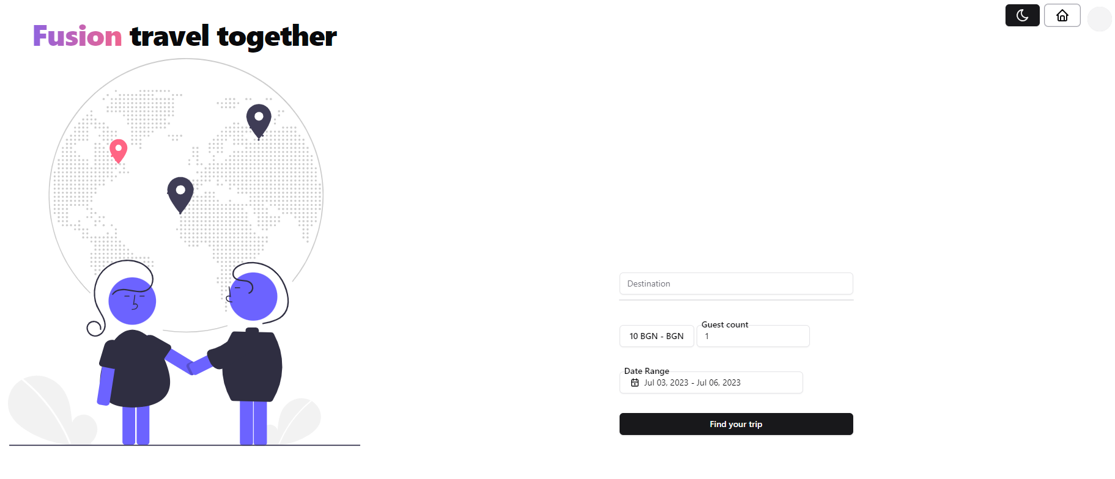
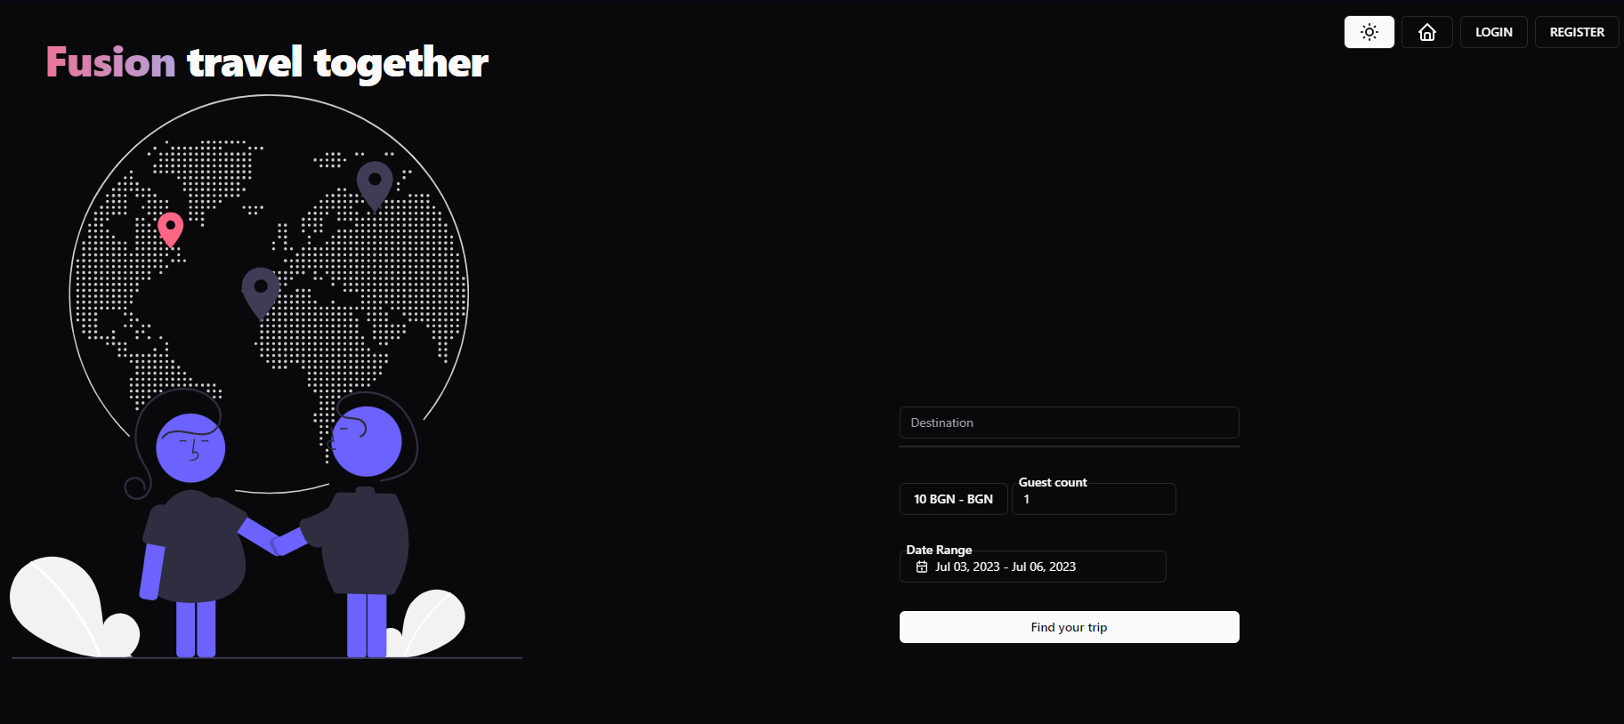
Realization: Theme changer

Slide 8
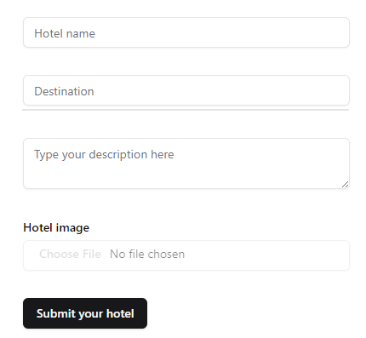
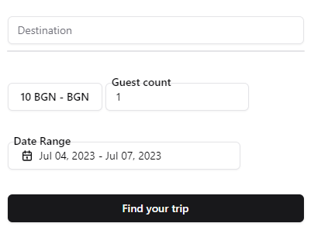
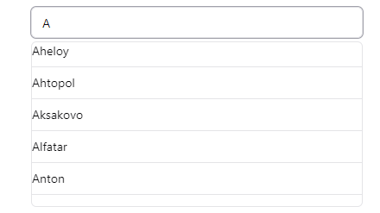
Realization: Fuzzy search Input fields

